Slide 1
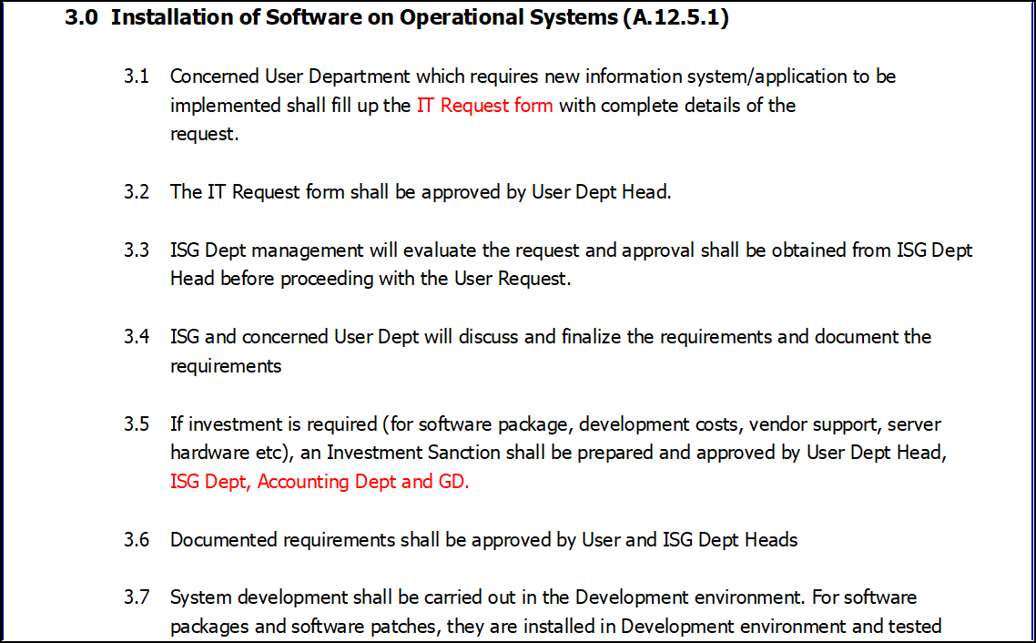
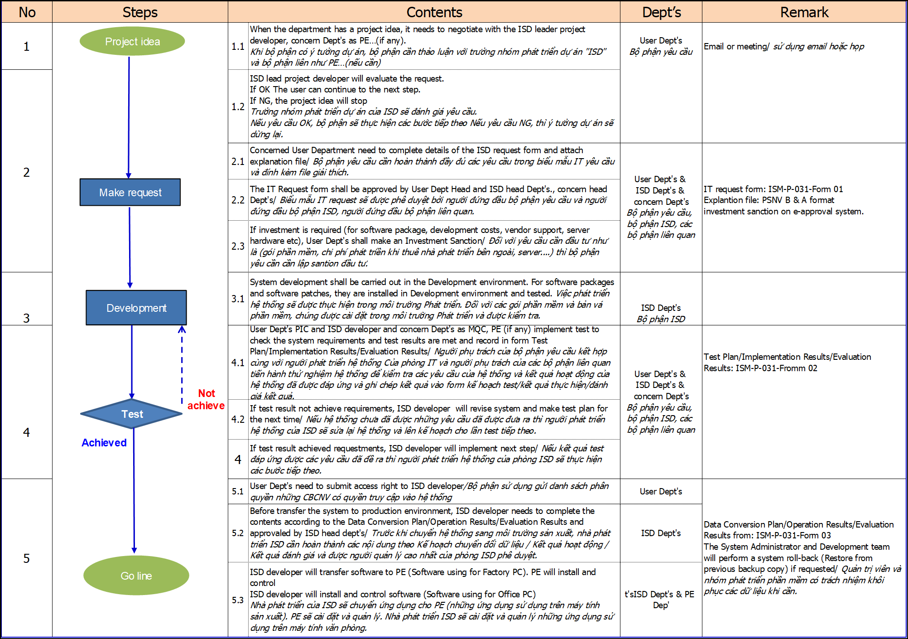
Visualize the System Development Project
1/1
Visualize the process, responsibilities, documents to System development project
Developer: Tran Thi Huong
Apply: Jun-2022
Expn: 0
Visualize the Process
◆Before
◆ After
Not show overview flow
Not show responsibility on step by step
Not show document relate for step by step
➔ User will be difficult understand and follow.
Combine all in one ==> User easily understand and follow

